Slide 1
ALL PAIR SHORTEST PATH
Floyd-Warshall Algorithm

Slide 2
THE FLOYD-WARSHALL ALGORITHM
2
Given:
  Directed, weighted graph G = (V, E)
  Negative-weight edges may be present
  No negative-weight cycles could be present in the graph
Compute:
  The shortest paths between all pairs of vertices in a graph
3
4
1
8
3
2
-4
1
-5
7
5
4
6

Slide 3
THE STRUCTURE OF A SHORTEST PATH
Vertices in G are given by
V = {1, 2, …, n}
Consider a path p = ⟨v₁, v₂, …, v_{l}⟩
  An intermediate vertex of p is any vertex in the set {v₂, v₃, …, v_{l-1}}
  E.g.: p = ⟨1, 2, 4, 5⟩: {2, 4}
  p = ⟨2, 4, 5⟩: {4}
3
6
0.5
1
2
3
4
2
1
2
5

Slide 4
THE STRUCTURE OF A SHORTEST PATH
For any pair of vertices i, j ∈ V, consider all paths from i to j whose intermediate vertices are all drawn from a subset {1, 2, …, k}
  Find p, a minimum-weight path from these paths
p₁
i
p_{u}
j
p_{t}
No vertex on these paths has index > k

Slide 5
EXAMPLE
d_{ij}^{(k)} = the weight of a shortest path from vertex i to vertex j with all intermediary vertices drawn from {1, 2, …, k}
d₁₃⁽⁰⁾ =
d₁₃⁽¹⁾ =
d₁₃⁽²⁾ =
d₁₃⁽³⁾ =
d₁₃⁽⁴⁾ =
6
6
3
6
0.5
1
2
5
3
4
2
1
5
4.5

Slide 6
THE STRUCTURE OF A SHORTEST PATH
k is not an intermediate vertex of path p
  Shortest path from i to j with intermediate vertices from {1, 2, …, k} is a shortest path from i to j with intermediate vertices from {1, 2, …, k - 1}
k is an intermediate vertex of path p
  p₁ is a shortest path from i to k
  p₂ is a shortest path from k to j
  k is not intermediary vertex of p₁, p₂
  p₁ and p₂ are shortest paths from i to k with vertices from {1, 2, …, k - 1}
k
i
j
p₁
∞
p₂
k
j
i

Slide 7
A RECURSIVE SOLUTION (CONT.)
d_{ij}^{(k)} = the weight of a shortest path from vertex i to vertex j with all intermediary vertices drawn from {1, 2, …, k}
k = 0
d_{ij}^{(k)} =
w_{ij}

Slide 8
A RECURSIVE SOLUTION (CONT.)
d_{ij}^{(k)} = the weight of a shortest path from vertex i to vertex j with all intermediary vertices drawn from {1, 2, …, k}
k ≥ 1
Case 1: k is not an intermediate vertex of path p
d_{ij}^{(k)} =
k
i
j
d_{ij}^{(k-1)}

Slide 9
A RECURSIVE SOLUTION (CONT.)
d_{ij}^{(k)} = the weight of a shortest path from vertex i to vertex j with all intermediary vertices drawn from {1, 2, …, k}
k ≥ 1
Case 2: k is an intermediate vertex of path p
d_{ij}^{(k)} =
∞
k
j
i
d_{ik}^{(k-1)} + d_{kj}^{(k-1)}

Slide 10
COMPUTING THE SHORTEST PATH WEIGHTS
d_{ij}^{(k)} = w_{ij} if k = 0
min {d_{ij}^{(k-1)} , d_{ik}^{(k-1)} + d_{kj}^{(k-1)} } if k ≥ 1
The final solution: D^{(n)} = (d_{ij}^{(n)}):
d_{ij}^{(n)} = δ(i, j) ∀ i, j ∈ V
j
j
+
(k, j)
i
i
(i, k)
D^{(k-1)}
D^{(k)}

Slide 11
THE FLOYD-WARSHALL ALGORITHM
Floyd-Warshall(W[1..n][1..n])
01 D ← W // D⁽⁰⁾
02 for k ← 1 to n do // compute D^{(k)}
03 for i ←1 to n do
04 for j ←1 to n do
05 if D[i][k] + D[k][j] < D[i][j] then
06 D[i][j] ← D[i][k] + D[k][j]
07 return D
Running Time: O(n³)

Slide 12
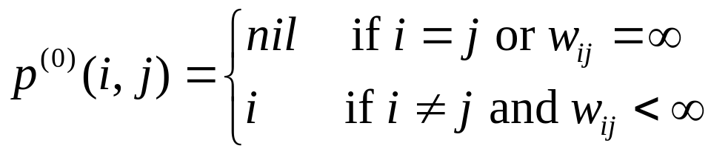
COMPUTING PREDECESSOR MATRIX
How do we compute the predecessor matrix?
  Initialization:
  Updating: p^{(k)}(i,j) = p^{(k-1)}(i,j) if(d^{(k-1)}(i,j)<=d^{(k-1)}(i,k)+(d^{(k-1)}(k,j)
  p^{(k-1)}(k,j) if(d^{(k-1)}(i,j) > d^{(k-1)}(i,k)+(d^{(k-1)}(k,j)
Floyd-Warshall(W[1..n][1..n])
01 …
02 for k ← 1 to n do // compute D^{(k)}
03 for i ←1 to n do
04 for j ←1 to n do
05 if D[i][k] + D[k][j] < D[i][j] then
06 D[i][j] ← D[i][k] + D[k][j]
07 P[i][j] ← P[k][j]
08 return D

Slide 13
EXAMPLE
d_{ij}^{(k)} = min {d_{ij}^{(k-1)} , d_{ik}^{(k-1)} + d_{kj}^{(k-1)} }
D⁽⁰⁾ = W
D⁽¹⁾
2
1
2
3
4
5
1
2
3
4
5
3
4
1
0 | 3 | 8 | ∞ | -4
∞ | 0 | ∞ | 1 | 7
∞ | 4 | 0 | ∞ | ∞
2 | ∞ | -5 | 0 | ∞
∞ | ∞ | ∞ | 6 | 0
1
0
3
8
∞
-4
1
8
3
2
2
∞
0
∞
1
7
2
1
3
3
∞
4
0
∞
∞
-4
7
-5
5
4
4
4
2
5
-5
0
-2
6
5
5
∞
∞
∞
6
0
D⁽²⁾
1
2
3
4
5
D⁽³⁾
D⁽⁴⁾
1
0
3
8
4
-4
0
3
8
4
-4
0
3
-1
4
-4
2
∞
0
∞
1
7
∞
0
∞
1
7
3
0
-4
1
-1
3
∞
4
0
5
11
∞
4
0
5
11
7
4
0
5
3
4
2
5
-5
0
-2
2
-1
-5
0
-2
2
-1
-5
0
-2
5
∞
∞
∞
6
0
∞
∞
∞
6
0
8
5
1
6
0

Slide 14
EXAMPLE
d_{ij}^{(k)} = min {d_{ij}^{(k-1)} , d_{ik}^{(k-1)} + d_{kj}^{(k-1)} }
D⁽⁵⁾
P⁽⁵⁾
2
1
2
3
4
5
1
2
3
4
5
3
4
1
0 | 1 | -3 | 2 | -4
3 | 0 | -4 | 1 | -1
7 | 4 | 0 | 5 | 3
2 | -1 | -5 | 0 | -2
8 | 5 | 1 | 6 | 0
1
-
3
4
5
1
1
8
3
2
2
4
-
4
2
1
2
1
3
3
4
3
-
2
1
-4
7
-5
5
4
4
4
4
3
4
-
1
6
5
5
4
3
4
5
-
Source: 5, Destination: 1
Shortest path: 8
Path: 5 …1 : 5…4…1: 5->4…1: 5->4->1
Source: 1, Destination: 3
Shortest path: -3
Path: 1 …3 : 1…4…3: 1…5…4…3: 1->5->4->3

Slide 15
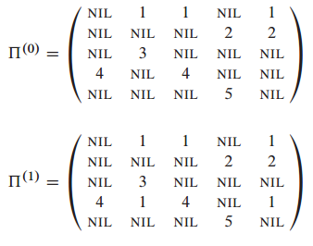
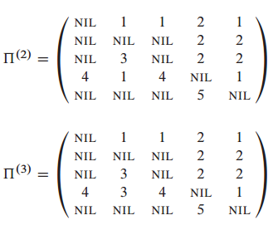
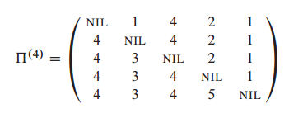
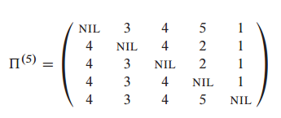
PATH MATRIX

Slide 16
PRINTPATH FOR WARSHALL’S ALGORITHM
PrintPath(s, t)
{
if(P[s][t]==nil) {print(“No path”);return;}
else if (P[s][t]==s){
print(s);
}
else{
print_path(s,P[s][t]);
print_path(P[s][t], t);
}
}
Print (t) at the end of the PrintPath(s,t)

Slide 17
QUESTION
Why should we use D[i, j] instead of D^{(k)}[i, j]?
Exercise:
  25.2-4: Memory O(n²)
  25.2-6: Negative weight cycle
  Find the shortest positive cycle

Slide 18
TRANSITIVE CLOSURE OF THE GRAPH
Input:
  Un-weighted graph G: W[i][j] = 1, if (i,j)∈E, W[i][j] = 0 otherwise.
Output:
  T[i][j] = 1, if there is a path from i to j in G, T[i][j] = 0 otherwise.
Algorithm:
  Just run Floyd-Warshall with weights 1, and make T[i][j] = 1, whenever D[i][j] < ∞.
  More efficient: use only Boolean operators

Slide 19
TRANSITIVE CLOSURE ALGORITHM
Transitive-Closure(W[1..n][1..n])
01 T ← W // T⁽⁰⁾
02 for k ← 1 to n do // compute T^{(k)}
03 for i ←1 to n do
04 for i ←1 to n do
05 T[i][j] ← T[i][j] ∨ (T[i][k] ∧ T[k][j])
06 return T

Slide 20
READINGS
Chapters 25
Video tutorial: https://www.youtube.com/watch?v=oNI0rf2P9gE

